Slide 1
Machine Learning
Machine Learning Introduction to Machine Learning by Kumar Anurupam is licensed under a Creative Commons Attribution-4.0 International License.
Decision Tree Classification – Ensemble Methods
CS 3104 Fall 2019
Lecture Slides by Kumar Anurupam

Slide 2
Learning Objectives
After completion of today’s session you will be able to:
Explain the motivation behind ensemble methods.
Elaborate the concept of Bagging and Boosting

Slide 3
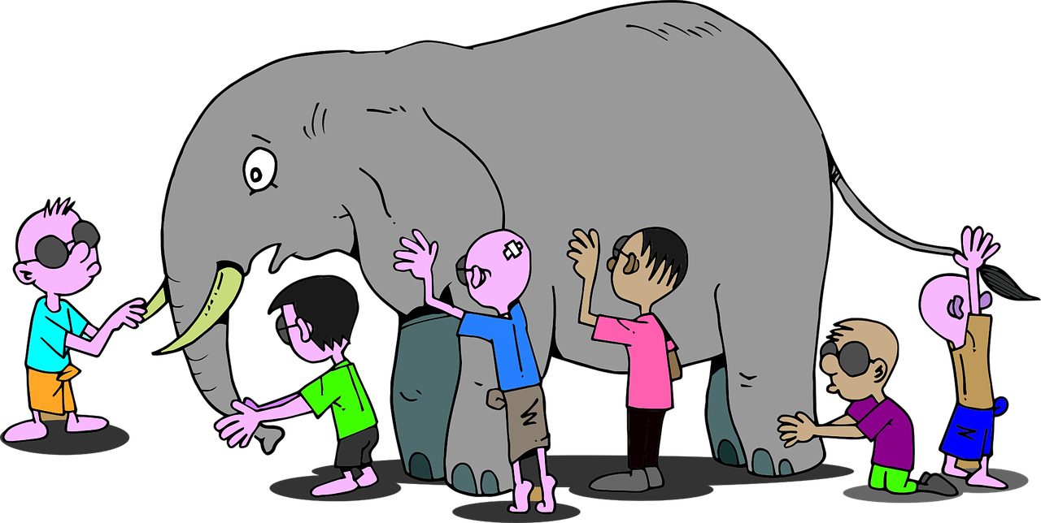
Motivation - I

Slide 4
Motivation - II
Suppose you are a billionaire and looking to purchase a T20 cricket team/franchise(Sixer: Roof Breakers [SRB]) to sponsor in a tournament(T20 Cracker Blast) where 8 teams competes every year.
You don’t have enough information regarding the team but you desperately want to invest in it by analyzing the win probability.
So, before making the deal you started doing some research on the team by meeting various people and making a note of their observation about win predictions.
The observations are mentioned as:

Slide 5
Motivation – II – contd…
Captain of SRB: He knows the players and have the information about their form but lacks the information about other teams. In the past his predictions of win has been 75% correct.
Coach of SRB: He knows the strategies of the team but lacks the information about the new players of the franchise. In past his predictions of win has been 70% correct.
Physio of SRB: He has the information about the physical and mental status of the players but limited information about the players of other team. In past his predictions of win has been 60% correct.

Slide 6
Motivation – II – contd…
Local Cricket Analyst: The person has good cricketing brain and knows about the past history of SRB but has very less insider information. In past his predictions of win has been 75% correct.
Other Team’s Captain: He has all the information about his team but has no idea about the new player transfer/purchase by SRB. In past his predictions of win has been 65% correct.
International Cricket Analyst: The person has done some good predictions earlier by taking into all the known factors of the game. In past his predictions of win has been 70% correct.

Slide 7
Motivation – II – contd…
By taking into the consideration all the analysis you can take an informed decision about the purchase.
Combined Accuracy = ?
= 1 – 25% * 30% * 40% * 25% * 35% * 30%
= 1 – 0.0007875
= 0.9992125
= 99.92%
Assumption in the model is that all the observation are independent.
If lets say all the people are from same domain and having same prediction then we may not always be able to achieve the accuracy more than 99%.

Slide 8
Ensemble Method/Learning
Ensemble is the art of combining diverse set of learners (individual models) together to improvise on the stability and predictive power of the model.
Ensemble methods combine several decision trees classifiers to produce better predictive performance than a single decision tree classifier.
The main principle behind the ensemble model is that a group of weak learners come together to form a strong learner, thus increasing the accuracy of the model.
Ensemble methods are meta-algorithms that combine several machine learning techniques into one predictive model in order to decrease variance (bagging), bias (boosting), or improve predictions (stacking).

Slide 9
Bagging
BAGGing, or Bootstrap AGGregating. BAGGing gets its name because it combines Bootstrapping and Aggregation to form one ensemble model.
Given a sample of data, multiple bootstrapped subsamples are pulled. A Decision Tree is formed on each of the bootstrapped subsamples.
After each subsample Decision Tree has been formed, an algorithm is used to aggregate over the Decision Trees to form the most efficient predictor.
Bagging is the application of the Bootstrap procedure to a high-variance machine learning algorithm, typically decision trees.
Bagging tries to implement similar learners on small sample populations and then takes a mean of all the predictions.
In generalized bagging, you can use different learners on different population. As you can expect this helps us to reduce the variance error.

Slide 10
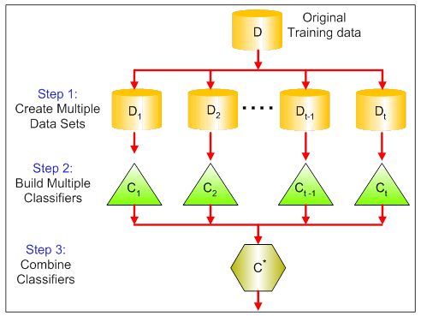
Bagging

Slide 11
Boosting
Boosting refers to a group of algorithms that utilize weighted averages to make weak learners into stronger learners.
Boosting is an iterative technique which adjust the weight of an observation based on the last classification.
If an observation was classified incorrectly, it tries to increase the weight of this observation and vice versa.
Boosting in general decreases the bias error and builds strong predictive models. However, they may sometimes over fit on the training data.

Slide 12
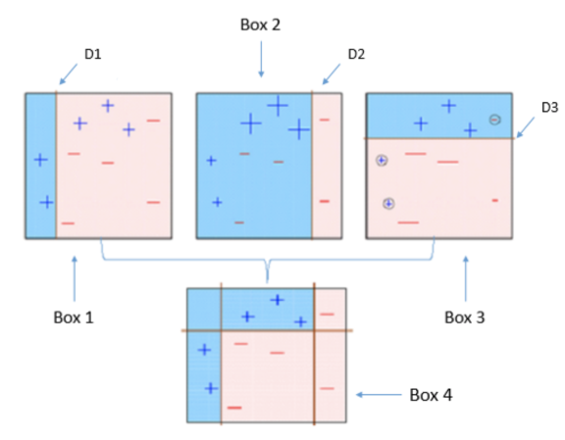
Boosting
We are having data points with equal weights assigned to them.
Three models are generated which are used to generate the final model.
This approach is unlike Bagging where each model is independent.
Here a model is developed by considering the previous instances
Decision Stump

Slide 13
References
[1] https://www.analyticsvidhya.com/blog/2015/08/introduction-ensemble-learning/
[2] https://becominghuman.ai/ensemble-learning-bagging-and-boosting-d20f38be9b1e
[3] https://towardsdatascience.com/ensemble-methods-in-machine-learning-what-are-they-and-why-use-them-68ec3f9fef5f

Slide 14
Thanks

